Slide 1


VISVESVARAYA TECHNOLOGICAL UNIVERSITY
JNANA SANGAMA, BELAGAVI – 590 018, KARNATAKA
Janatha Education Society®
VIVEKANANDA INSTITUTE OF TECHNOLOGY
Gudimavu, Kumbalagodu Post, Kengeri Hobli, Bengaluru – 560 074
RETINAL BLOOD VESSEL SEGMENTATION
MINI PROJECT(18ECMP68 )
Under the guidance of : KUSHAL KUMAR K 1VK20EC011
Ms SUJATHA S ARI PUNITH KUMAR A 1VK20EC018
Assistant professor MADHU SHREE C L 1VK20EC013
Dept of ECE, VKIT SRIKANTH P V 1VK20EC021

Slide 2

Retinal Blood Vessel Segmentation

Slide 3
ABSTRACT
Retinal vascular diseases are the utmost cause of visibility loss and blindness where the blood vessels in the eyes somehow fail to circulate the appropriate level of blood flow.
Early and correct detection of retinal blood vessels facilitates humans to take expedient remedy which can significantly reduce possible vision loss.
This paper presents a Retinal Blood Vessel Segmentation (RBVS) which is inspired by the popular MATLAB architecture.
Proper utilization of deep learning lead MATLAB to achieve to outperform the state of the art accuracy. where the proposed approach achieves more than 96% average accuracy for vessel segmentation
Therefore, this study helps to find out major problems diagnosis that is the segmentation of retinal blood vessels in fundus images followed by the length of the segmented blood vessels.

Slide 4
Introduction
Main target of this project is to detect and process the given retinal fundus image to find the length of the each blood vessels in the image.
We use MATLAB programming for the Image segmentation.
In MATLAB we use Deep Learning Tool box, Image processing tool box, Statistics and machine learning tool box .
This project requires this tool boxes to process the given fundus image and measure the length of the segmented blood vessels.

Slide 5
LITERATURE SURVEY
SI NO | NAME OF THE JOURNAL AND PUBLISHED PAPER | AUTHORS | CONCEPT SURVEYED
1. | RBVS-NET: “A ROBUST CONVOLUTIONAL NEURAL NETWORK FOR RETINAL BLOOD VESSEL SEGMENTATION” | Rafsanjany Kushol, and Md Sirajus Salekint | This paper proposes a Modi-Fied version of U-Net in the field of medical Imaging for segmenting vessels from the background of a retinal image that opens the door to apply the method in many more complex medical applications. Being inspired by the outcome of this research, we want to develop a similar vessel segmentation method
2. | A hybrid method to enhance Thick and thin vessels for blood vessel segmentation. | Dash S, Verma S, Khan M, Wozniak M, Shafi J, Ijaz MF | This paper recommends a new technique for making curvelet transform approach more robust for retinal blood vessel segmentation by integrating it with the Jerman filter for different cut-off threshold values of the Jerman filter. For segmentation purpose, mean C-thresholding technique is employed. The integration of the Jerman filter and curvelet decomposition strongly intensify both thick and thin vessels and hence delivers better segmentation performance than the original curvelet transform. Simulation results establish that the suggested integrated scheme effectively detects the blood vessels.
3. | Illumination normalized based technique for retinal blood vessel segmentation. | Dash S, Senapati MR, Sahu PK, Chowdary PSR | worked on an automated method for segmentation of retinal blood vessels. In which they used first order derivative of Gaussian filter, morphological top- hat transformation, and bit plane slicing.

Slide 6
SI NO | NAME OF THE JOURNAL AND PUBLISHED PAPER | AUTHORS | CONCEPT SURVEYED
4. | Multi-retinal disease classification by reduced deep learning features. Neural Comput Appl | Arunkumar R, Karthigaikumar P | In this work, Matlab is applied for the retinal blood vessel segmentation of images over the DRIVE Dataset. The method undergoes pre-processing grey Scale conversion and CLAHE, feature extraction Using morphological feature, segmentation, training and prediction using CNN. The results are evaluated In terms of the model accuracy as 0.9806 which is quite competitive with respect to the state-of-art work over the DRIVE. Because of the ease-to-use and good performance, the proposed method accelerates the diagnosis of Diabetic Retinopathy.
5. | A Study on Detection of Retinal Blood Vessels with their Geometrical Physical Characteristics for Retinopathy of Prematurity (ROP). | Ashish Kumar | In this work includes data which is of premature infants possessing retinopathy of prematurity. As for now with the available diagnostic tools, this paper uses new median filter and average filter to get the more clear image than the available once The retinal vessel segmentation is a tough task most of the methods are tested on publically available datasets which are of developed retina.

Slide 7
PROBLEM STATEMENT
Time consumption: The previously used techniques are more time consuming than this method
Accuracy: The accuracy in the previously proposed or using methods are not stable .
Manual Errors: Since the current methods require manual handling errors may occur unintentionally
Cost: Cost of the pervious methods are very high compare to this because of using highly sensitive equipment .

Slide 8
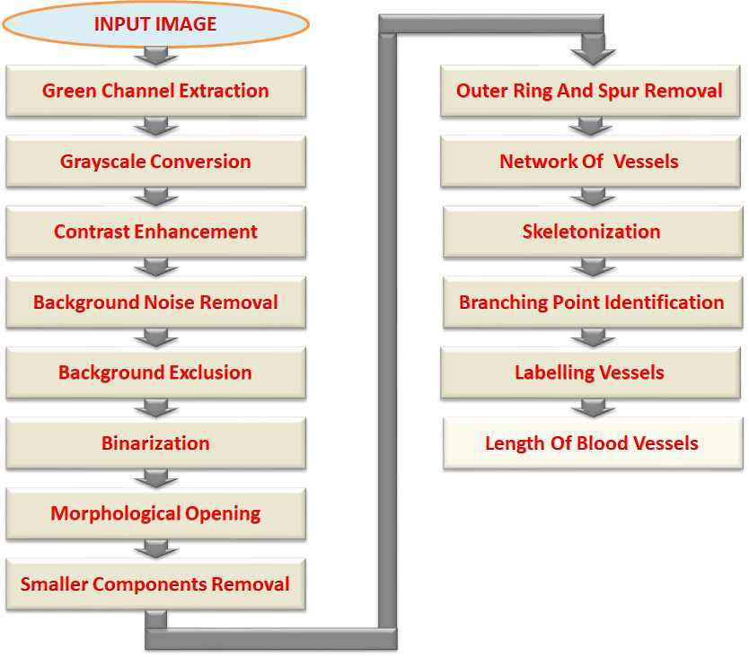
Flow chart

Slide 9
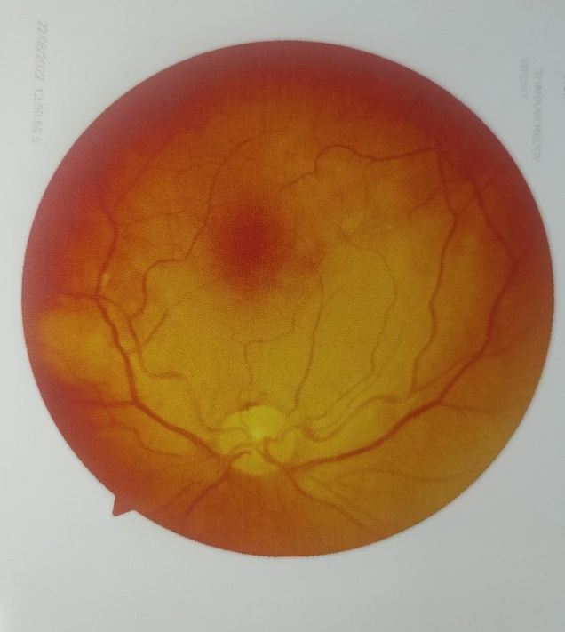
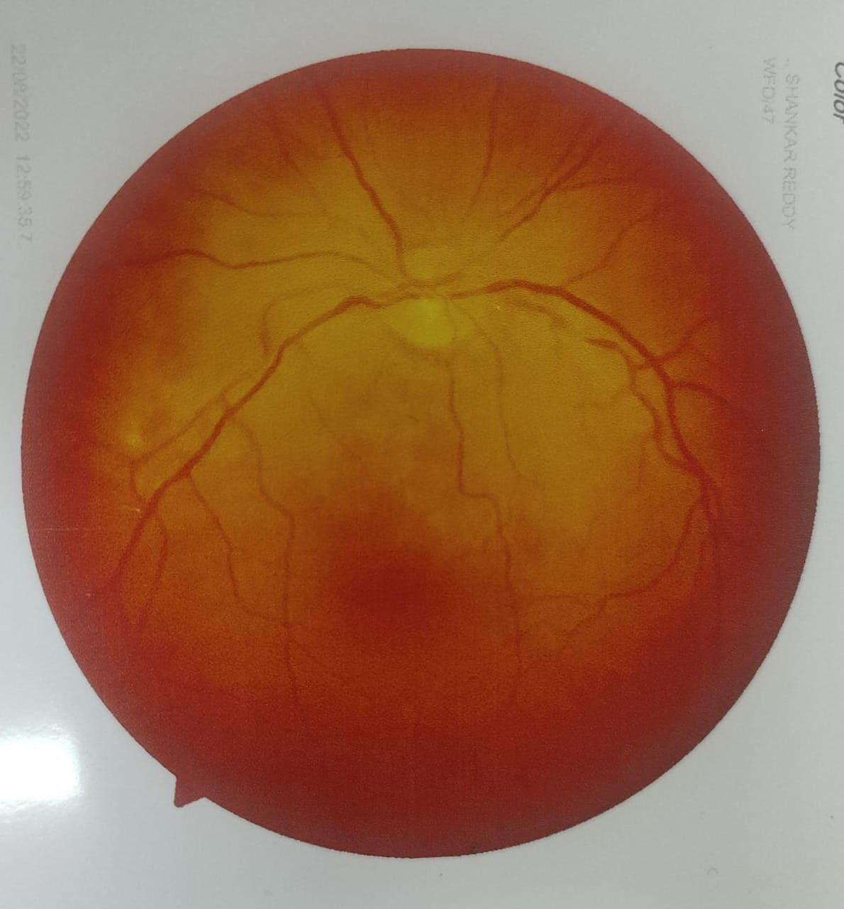
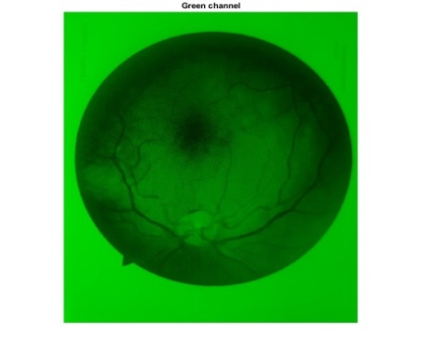
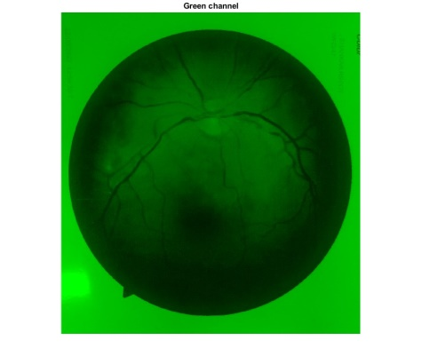
Data Set/Input Image
Green Channel Extraction

Slide 10
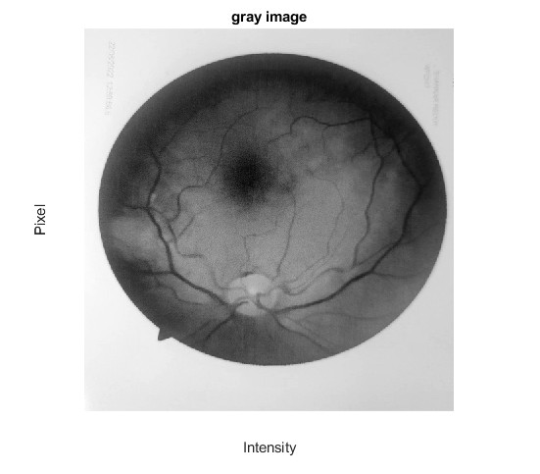
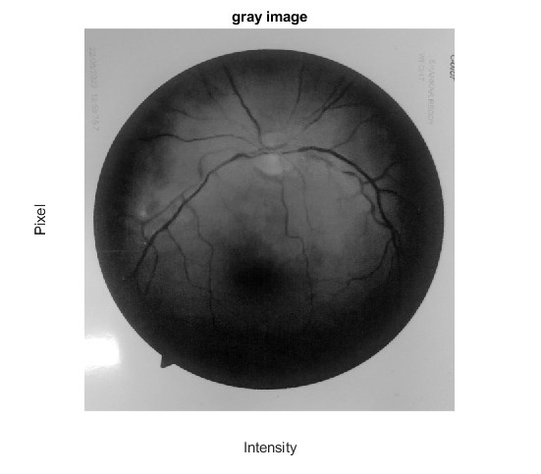
Gray Scale Conversion

Slide 11
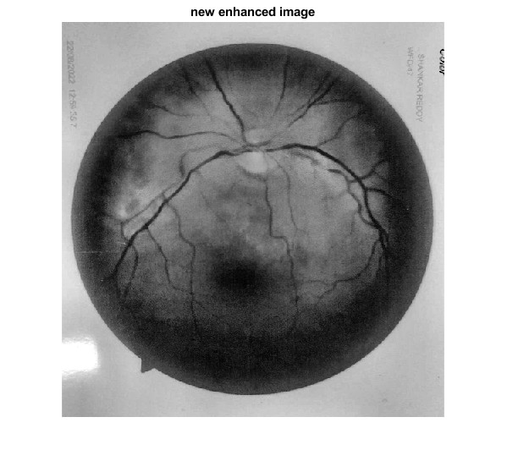
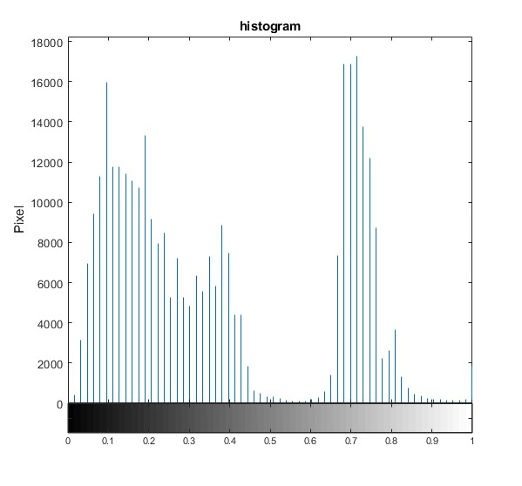
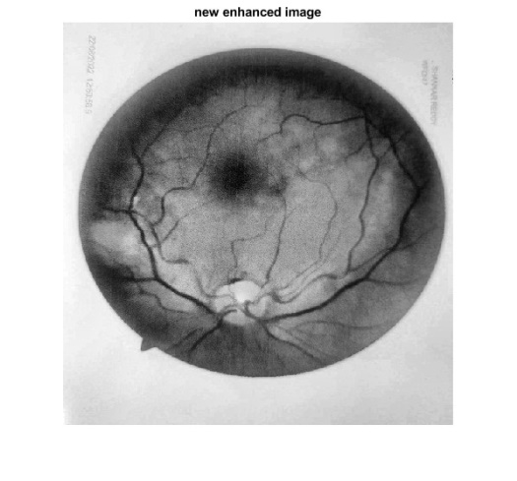
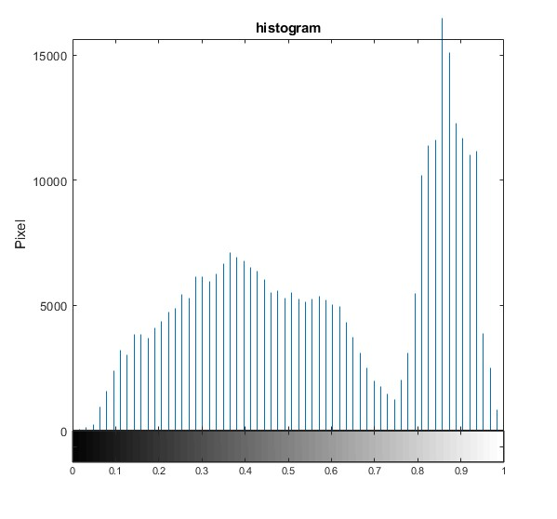
Contrast Enhancement

Slide 12
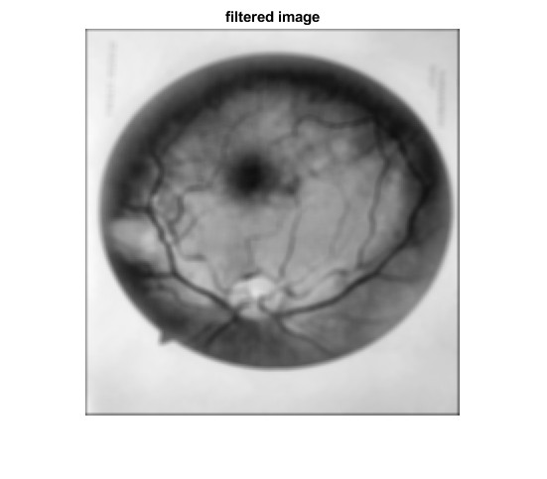
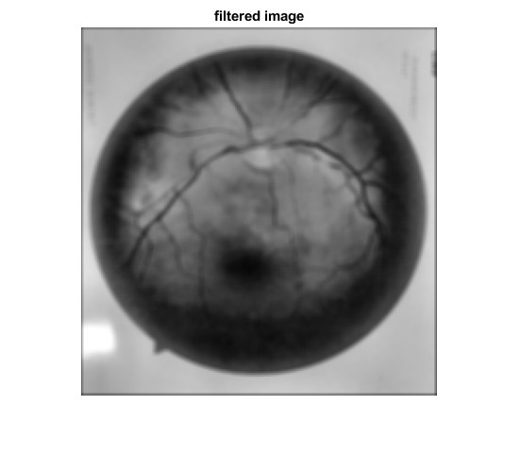
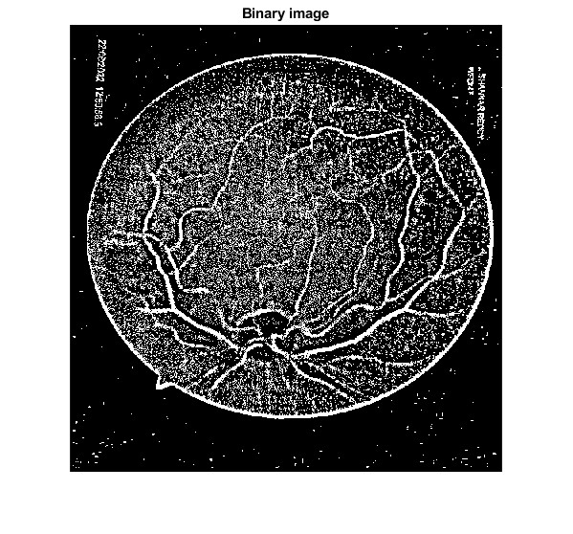
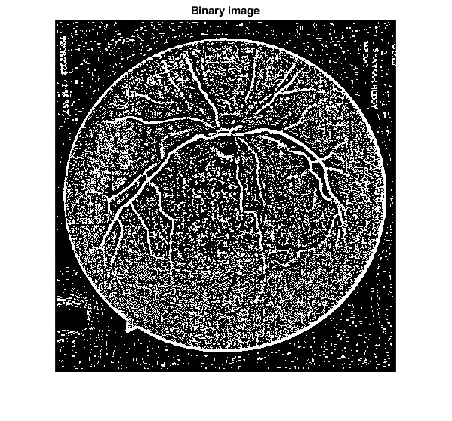
Background Exclusion
Binarization

Slide 13
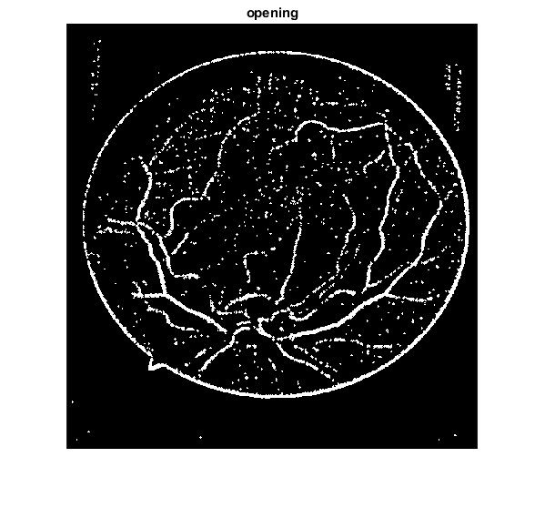
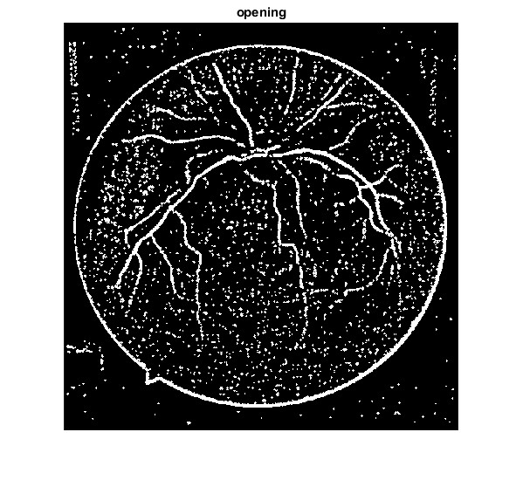
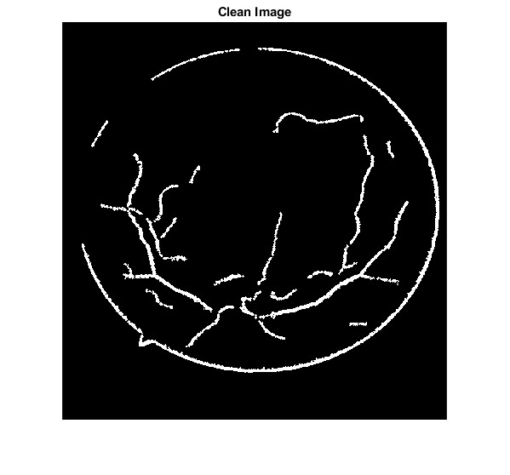
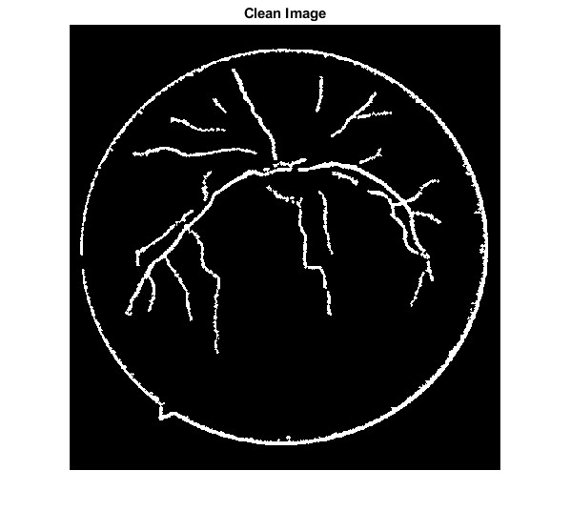
Morphological Opening
Smaller Components Removal

Slide 14
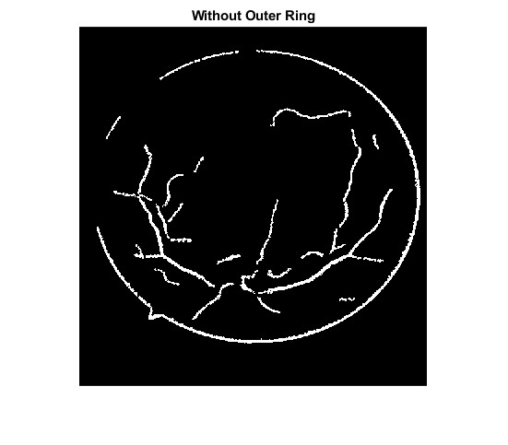
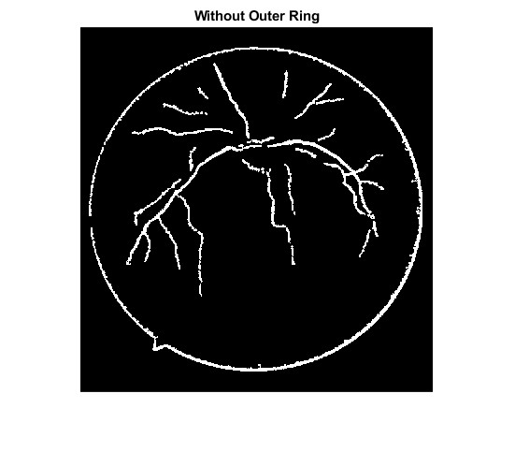
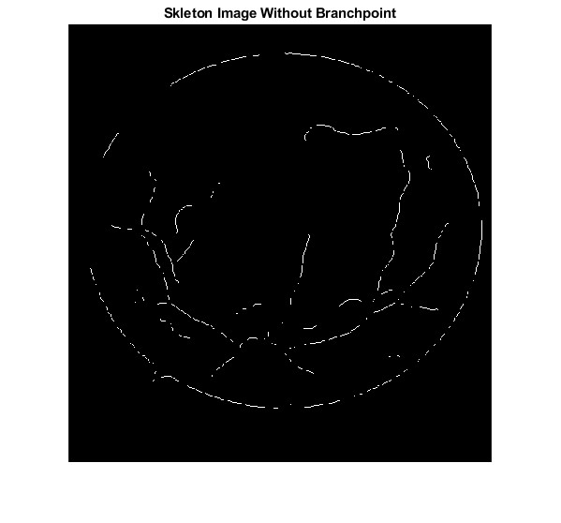
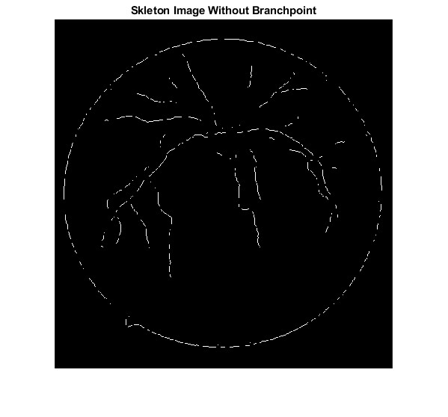
Outer Ring and Spur Removal
Skeletonization

Slide 15
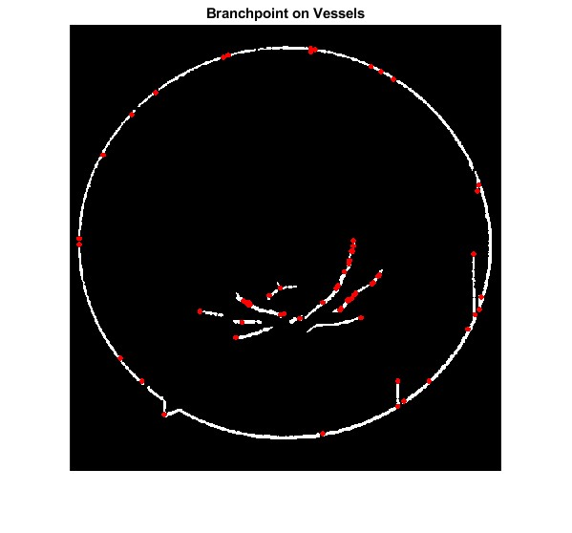
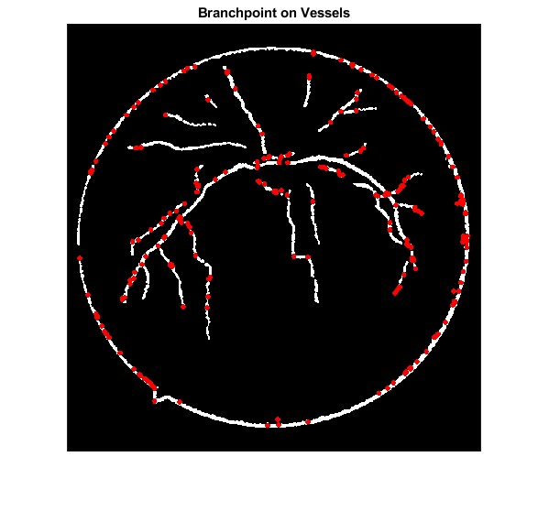
Geodisc Distance Image
Branching Point Identification

Slide 16
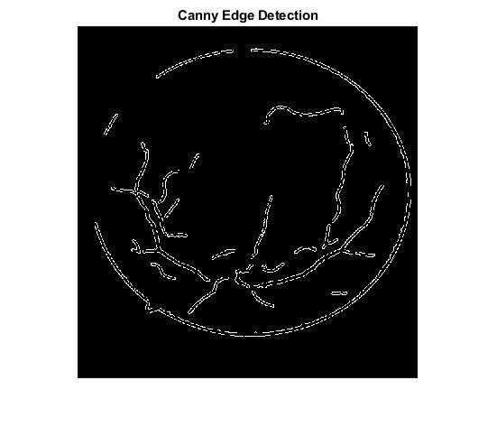
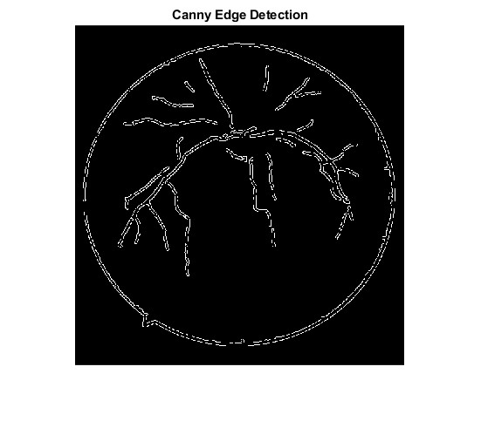
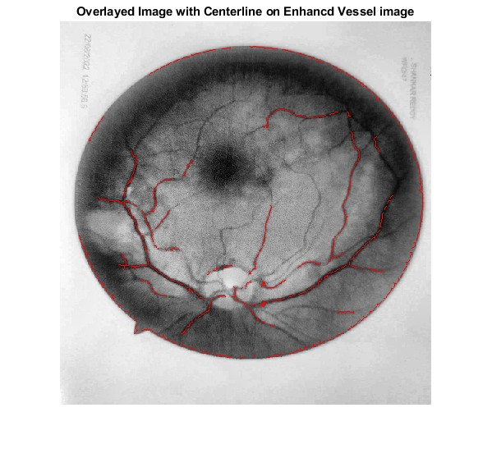
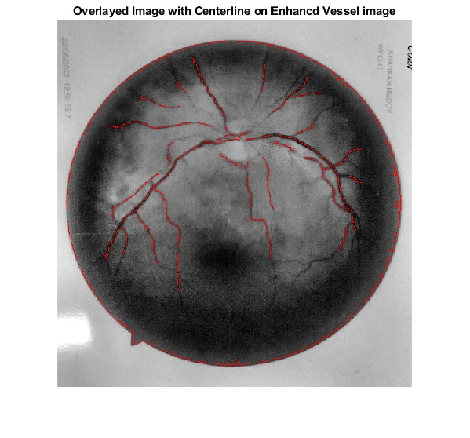
Canny Edge Detection
Overlayed Image

Slide 17
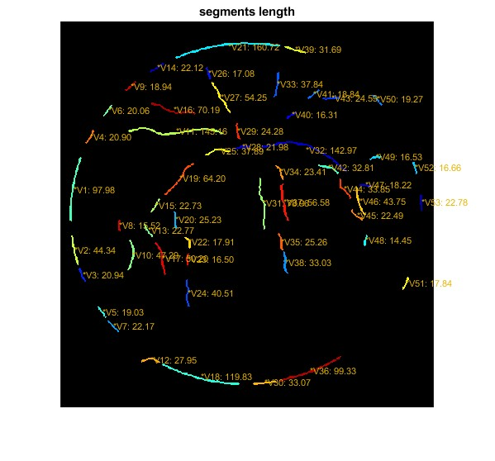
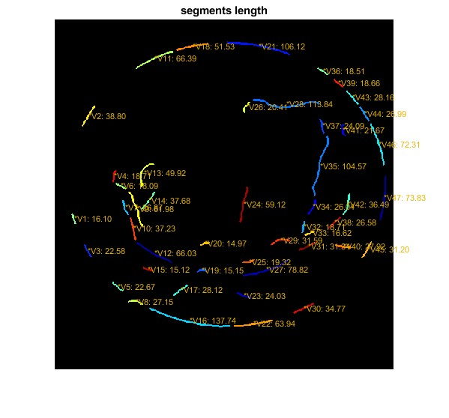
Length of Vessel Segments

Slide 18
Advantages
Disease diagnosis and monitoring
Quantitative analysis
Risk assessment
Image enhancement and visualization
Automated screening
Personalized treatment planning

Slide 19
Future Scope
AI models and tools have proven their efficiency in overcoming problems and capability of determining parameters for clinical definitions.
This study also has limitations which we will try to overcome. We will try to add initial preprocessing steps before segmentation of retinal blood vessels
For noise and illumination issues present in premature retinal fundus imagesalso to improve the contrast and to clean the fundus image.
In this study the model was incapable in identifying the missing regions and consider them as end points.
This problem can also be dealt with improving the segmentation results and enhancing models capability

Slide 20
Conclusion
According to the experimental results, our retinal vessel segmentation results showed an effective and easy way to reduce the noise present in retinal images and enhance the contrast.
Methods such as background noise removal, morphological opening using specific channel and removing smaller segments lead to a clear network of retinal blood vessels in eye images.
For length detection geodesic distance transform algorithm was used for calculating the approximate length of vessels as it gave more precise length results then other method.
Distance transformation used lead to precise calculation for vessels length.
All together it becomes an accommodating tool for ophthalmologist for finding the approximate measurements of the retinal blood vessels

Slide 21
Reference
RBVS-NET: “A ROBUST CONVOLUTIONAL NEURAL NETWORK FOR RETINAL BLOOD VESSEL SEGMENTATION” Rafsanjany Kushol, and Md Sirajus Salekint Department of Computing Science, University of Alberta, Edmonton, Alberta, Canada Department of Computer Science and Engineering, University of South Florida, Tampa, Florida, USA,2020 https://doi.org/10.1109/ICIP40778.2020.9190759
Dash S, Verma S, Khan M, Wozniak M, Shafi J, Ijaz MF (2021) A hybrid method to enhance Thick and thin vessels for blood vessel segmentation. Diagnostics11(11):2017. https://doi.org/10.3390/diagnostics11112017
Dash S, Senapati MR, Sahu PK, Chowdary PSR (2021) Illumination normalized basedtechnique for retinal blood vessel segmentation. Int J Imaging Syst Technol 31(1):351–363. https://doi.org/10.1002/ima.22461

Slide 22
Arunkumar R, Karthigaikumar P. Multi-retinal disease classification by reduced deep learning features. Neural Comput Appl. 2017;28(2):329–334
Ashish Kumar “A Study on Detection of Retinal Blood Vessels with their Geometrical Physical Characteristics for Retinopathy of Prematurity (ROP)”,Under The Guidance Of Prof. Yo-Ping Huang (2020).https://github.com/Ashishkumar-hub/Detection-of-Retinal-Blood-Vessels-with-their-Geometrical-Physical-Characteristics-for-ROP

Slide 23
THANK YOU

